Slide 1
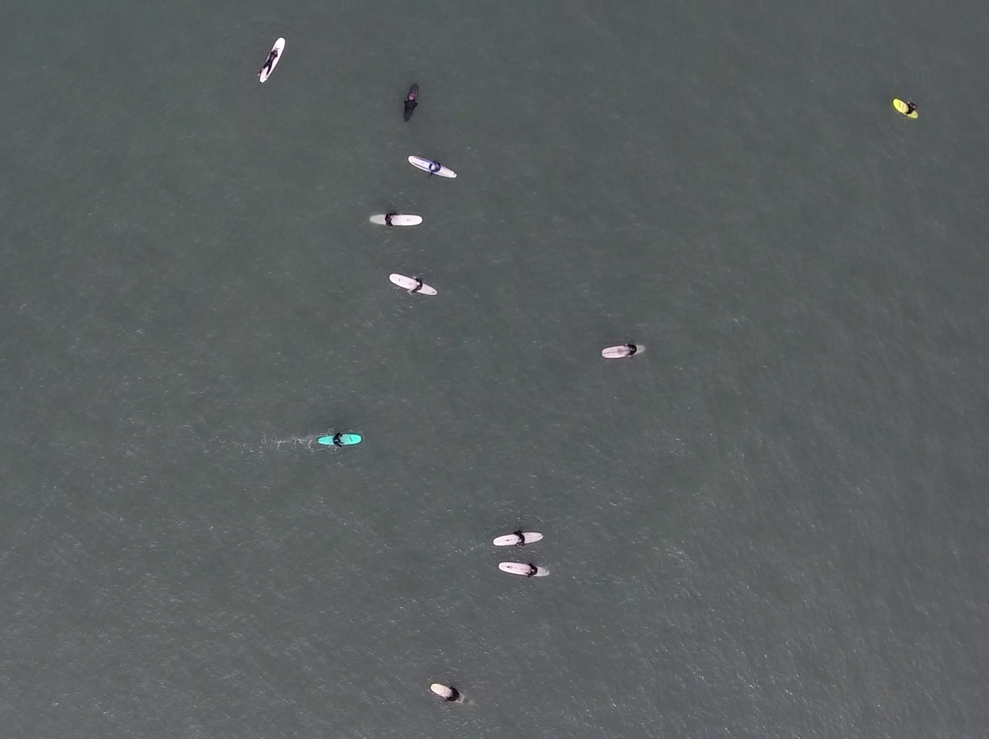
Identifying Humans in Drone Footage from Local Beaches
Photo by Patrick Rex
Echelle Burns – Feb 2020

Slide 2
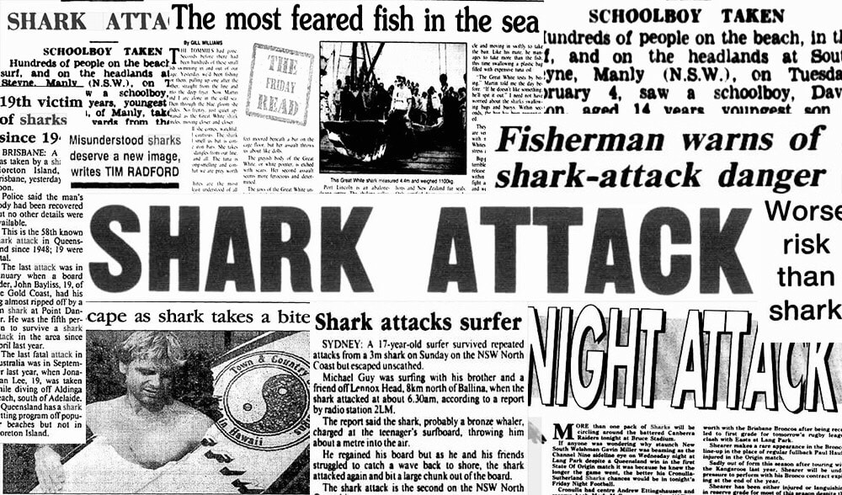


Introduction: The Problem
Shark Attacks are glorified in the media
Shark attacks do not occur as frequently as portrayed by pop culture
No current research on the spatio-temporal overlap between White Sharks (Carcharodon carcharias) and beach recreationalists

Slide 3
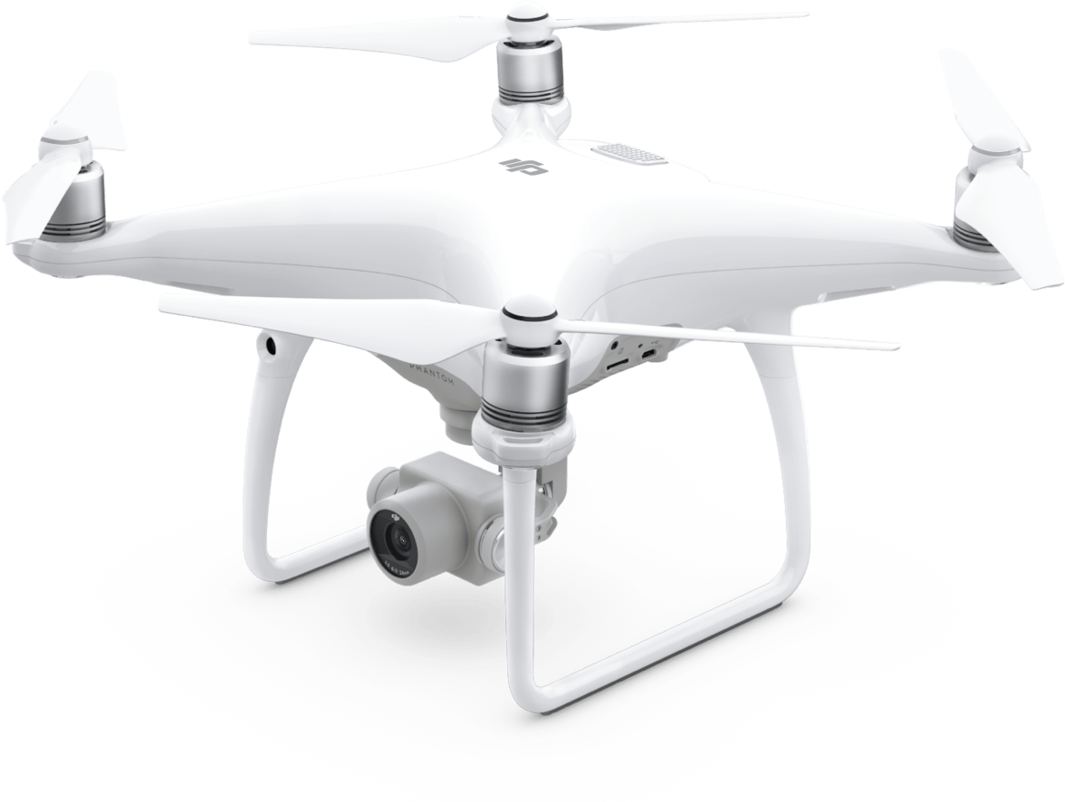
Introduction: The Solution
Drone Technology in Marine Biology:
Increasingly popular
Allows observation of animals without influencing their behavior
Caveats:
Amount of footage increases substantially with each drone flight
Need a fast way to identify whether humans are present in a image

Slide 4
Introduction: Project Objectives
Objectives:
Use a Deep Neural Network to identify how many people are present in each drone still image
Audience:
Researchers with similar problems or who are trying to answer similar research questions
11 humans

Slide 5

Data Sources
2,465 drone images (3840 x 2160 px) from CSU Long Beach Shark Lab
Surveys along beaches in Southern California
Include footage of:
Beach Recreationalists:
Walking
Wading
Swimming
Paddle boarding
Surfing
Kayaking
White Sharks
Other marine animals
Source: Scenic Sotheby’s International Realty

Slide 6
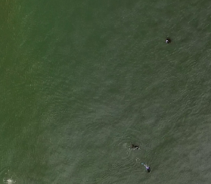
Methods: Image Labeling
Images resized (960 x 540 px) to make labeling easier
Manual labeling by placing dots on locations of humans
Labeled images saved in black and white
Original
Manual Labeling
Labeled Image

Slide 7
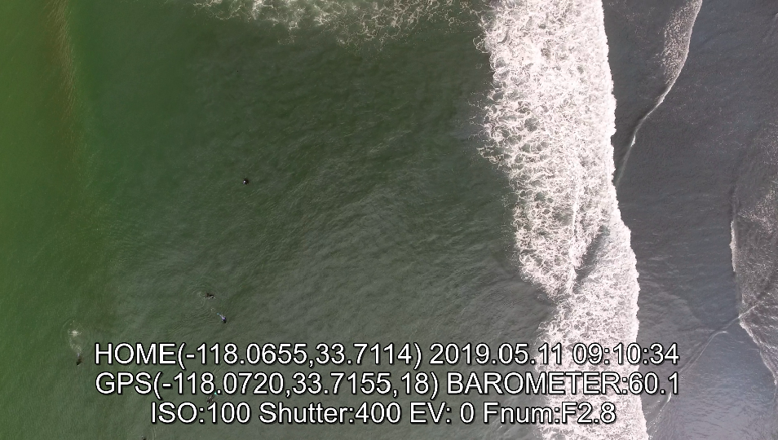

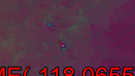

Methods: Image Slicing and Contrast Editing
Resized Images cut into 25 smaller images (192 x 108 px)
Increase model efficiency
Smaller images changed to grayscale/HSV to increase color contrast

Slide 8
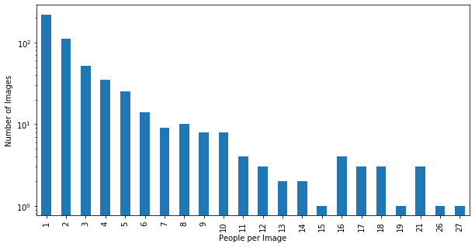
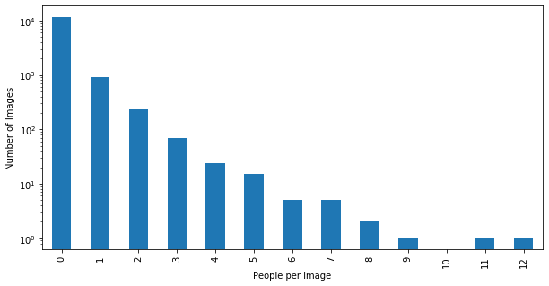
Methods/Results: Exploratory Data Analysis
521 images with humans present
Most with ≤ 7 humans
521 large images yielded 39,075 smaller images
~90% had 0 people
~7% had one person

